Slide 1

STORES SALES PREDICTION
Somay mangla

Slide 2
INTRODUCTION
Store Sales Prediction is the process of using a company’s sales records over the past years to predict the short-term or long-term sales performance of that company in the future. This is one of the pillars of proper financial planning. As with any prediction-related process, risk and uncertainty are unavoidable in Sales Forecasting too.

Slide 3
OBJECTIVE
The objective is to build a predictive model and find out the sales of each product at a particular store. Big Mart will use this model to understand the properties of products and stores which play a key role in increasing sales.

Slide 4
ARCHITECTURE
Import Libraries
Data Reading
Check null value and fill that value
EDA using Klib
Standardization
Label Encoding
Preprocessing
EDA using Pandas Profiling
Model Building
Deployment using flask
Application start
Data from user
Final Outcome

Slide 5
Dataset
1 Item Weight 2. Item Fat Content
3. Item Visibility 4. Item Type
5. Item Mrp 6. Outlet Year
7. Outlet Size 8. Outlet Location
9. Outlet Type 10. Outlet Supply

Slide 6
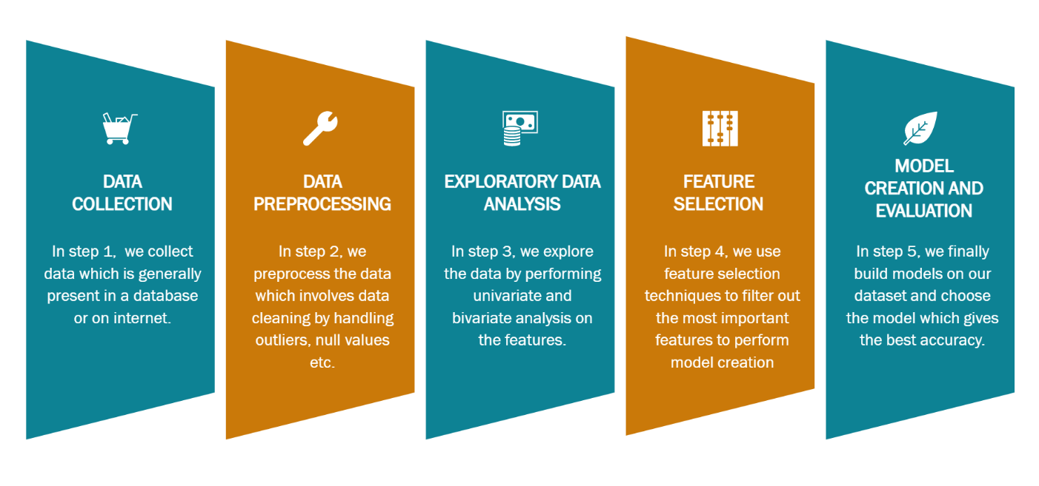
Data Analysis Step

Slide 7
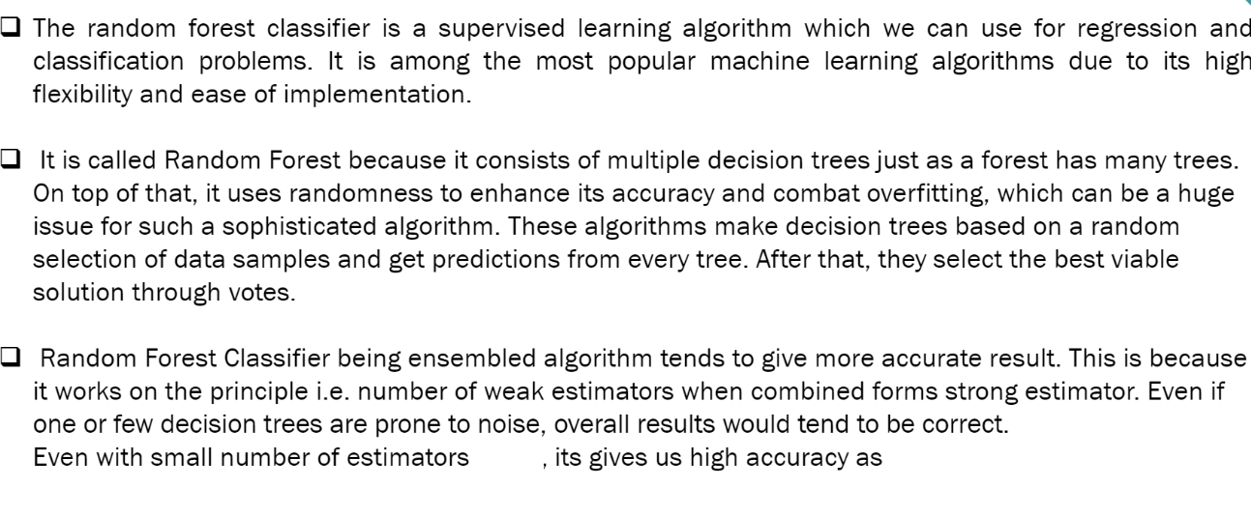
Random Forest Model
1000
80

Slide 8
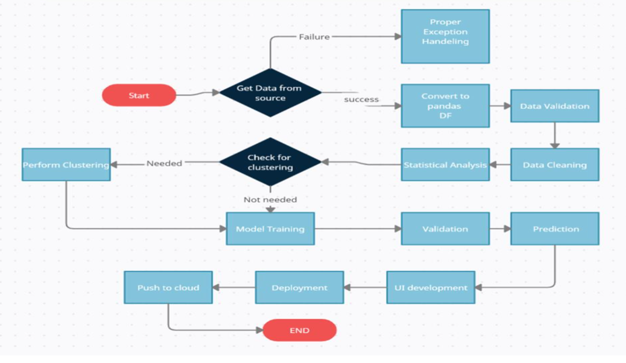
Model Training and Workflow

Slide 9
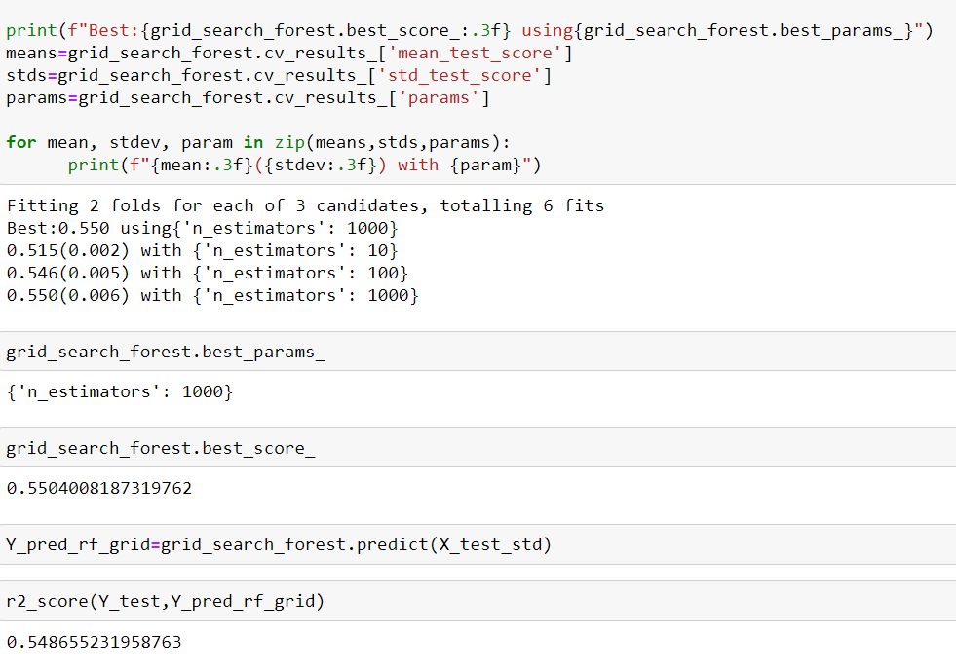
Model Predicting Result On Test Dataset

Slide 10




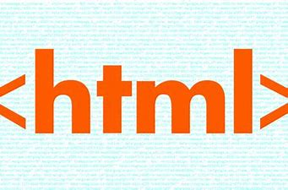
Deployment and IDE
The Final Deployment or web page is deployed by flask Framework and Heroku

Slide 11
Q & A
Q1) What’s the source of data?
Ans. The data for training is provided by the client from: https://www.kaggle.com/brijbhushannanda1979/bigmart-sales-data
Q 2) What was the type of data?
Ans. The data was the combination of numerical and Categorical values.
Q 3) What’s the complete flow you followed in this Project?
Ans. Refer the Architecture section for this.
Q 4) After the File validation what you do with incompatible file or files which didn’t pass the validation?
Ans. Files like these are moved to the Achieve Folder and a list of these files has been shared with the client and we removed the bad data folder.

Slide 12
Q 5) What techniques were you using for data pre-processing?
• Removing unwanted attributes
• Visualizing relation of independent variables with each other and output variables
• Checking and changing Distribution of continuous values
• Removing outliers
• Cleaning data and imputing if null values are present.
• Converting categorical data into numeric values.
• Scaling the data
Q 6) How training was done or what models were used?
• Before diving the data in training and validation set, we performed clustering over fit to divide the data into clusters.
• As per cluster the training and validation data were divided.
• The scaling was performed over training and validation data.
• Different algorithms tried using EvalML and Finalized algorithm is Random Forest.

Slide 13
Q 7) How Prediction was done?
Ans. The testing files are shared by the client. We pass its data to the best model which we have saved in sav format and get the prediction.
Q 8) Where the model was deployed?
Ans. When the model is ready, we deploy it in Heroku platform. This model is a web application where user can enter the data and these data gets extracted in the backend and user gets the prediction result.

